Slide 1
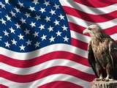
EXPRESSED POWERS
Money and Commerce

Slide 2
The Power to Tax
A Tax is a charge levied by government on persons or property to raise money to meet public needs.
Congress does not have an unlimited power to tax.
Tax collecting cannot go against another part of the constitution
For example, Congress cannot tax a church as this would violate a part of the Constitution.
Notes:
Current events

Slide 3
LIMITS ON THE TAXING POWER
There are 4 explicit limitations on taxing power:
1) Congress may only tax for public purposes-not private benefit; levied “only to pay the Debts and provide for the common Defense and general Welfare of the United States”.
2) Congress may not tax exports; Article I, Section 9, Clause 5 declares “no Tax or Duty shall be laid on Articles exported from any state”.

Slide 4
Limits On The Taxing Power
3) Direct taxes must be apportioned among states according to their populations.
4) All indirect taxes levied by the Government must be levied at the same rate in every part of the country.
Notes:
Direct taxes are ones that must be paid directly to the government by the person on whom it is imposed; examples are those of people who own land or buildings.
-Indirect tax is one first paid by one person but then passed on to another. Ex: Federal taxes on cigarettes- it is paid to the Treasury by the tobacco company but it is then passed on through the wholesaler and retailer to the individual who purchases the cigarettes.

Slide 5
The Borrowing Power: What is Public Debt?
Public Debt: All of the money borrowed by the Government over the years and not yet repaid PLUS the accumulated interest on that money.
There are NO constitutional limits on the amount of money that Congress may borrow.
There IS a limit on public debt as set forth by Congress.
However, Congress will raise the limit on public debt if there is the threat that the debt will exceed the limit

Slide 6
Borrowing Power
Deficit Financing is used by the Government because it spends more than it takes in each year, then borrows money to make up the difference
This method has been used to deal with the Great Depression of the 1930’s, to pay for World War II, and to fund wars and social programs.
http://www.brillig.com/debt_clock/

Slide 7
Tracking Government Spending

Slide 8
Where is this money being spent?
Notes:
Is there anything surprising to you about this chart?

Slide 9
Commerce Power
Commerce Power is the power of Congress to regulate interstate and foreign trade-this is vital to the welfare of the nation right along with the taxing power.
The Commerce Clause was written by the framers of the constitution; this Clause proved to be more responsible for building a strong Nation out of a weak confederation than any other provision in the constitution

Slide 10
Limits on Commerce Power
The Constitution places four explicit limits on the use of commerce power. Congress cannot:
Tax exports
Congress cannot favor the ports of one state over those of any other in the regulation of trade
Congress cannot require that Vessels bound to, or from, on State, cannot be obliged to enter, clear or pay Duties in another.
Congress could not interfere with the slave trade until 1808; this is no longer active.

Slide 11
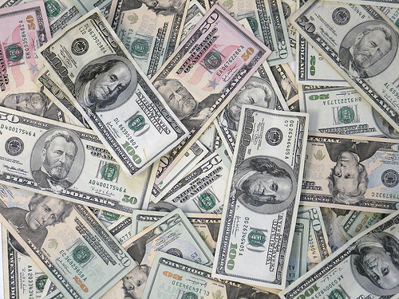
The Currency Power
Congress holds the ‘currency power’, which provides the nation with a uniform, stable monetary system
Legal tender is any kind of money that a creditor must by law accept in payment for debts.
Today, national notes are known as “greenbacks”.

Slide 12
Making money out of nothing
http://www.youtube.com/watch?v=99DYh8Zpkpw

Slide 13
The Bankruptcy Power
Congress has the power to uniform Laws on the subject of bankruptcies.
A bankrupt individual or company, or other organization, is one a court has found to be insolvent-this means that they are unable to pay debts in full.
Bankruptcy is the legal proceeding in which the bankrupt’s assets-however much or little they may be-are distributed among those to whom a debt is owed; this frees the bankrupt individual from legal responsibility from his/her debts.

Slide 14
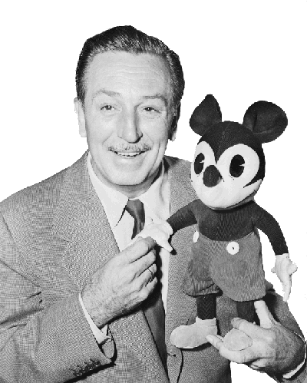
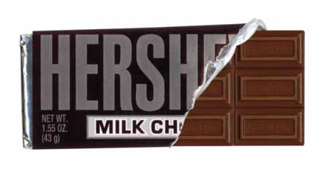
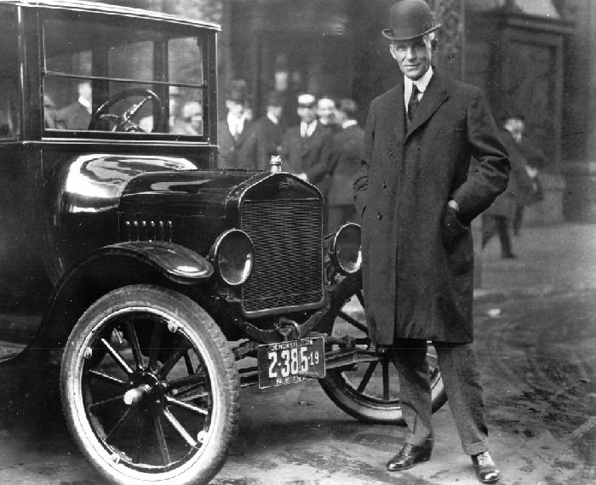
Fun Facts: Corporate and Famous Bankruptcies
Blockbuster Video: 2010
General Motors: 2009
Walt Disney:1923
Larry King: 1978
Milton Hershey: 1882
Donald Trump
Henry Ford: 1901

Slide 15
Other Expressed Powers
Congress has Foreign Relations Powers.
The U.S. Government has greater powers in the field of foreign affairs than in any other area.
These powers of Congress come from two sources:
1) Various expressed powers such as the wars powers and the power to regulate foreign commerce
2) The U.S. is a sovereign state in the world community; as the nation’s lawmaking body Congress has the power to act on matters affecting the security of the nation.
Notes:
Immigration and measures to combat terrorism here and abroad.

Slide 16
War Powers
Eight of the expressed powers given to Congress deal with war and national defense; it is here that Congress also shares power with the chief executive, aka the President.
Only Congress can declare war. Congress also has the power to raise and support armies, to provide and maintain a navy, and to make rules pertaining to the governing of land and naval forces.
With the passage of War Powers Resolution of 1973, Congress claimed the power to restrict the use of American forces in combat where a state of war does not exist.

Slide 17
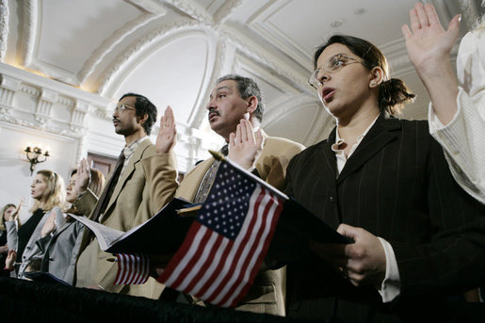
Expressed Powers
Naturalization: The process by which citizens of one country become citizens of another.
Congress has the exclusive power to establish a uniform rule of Naturalization.
There are currently 11 million naturalized citizens in the United States.

Slide 18
Postal Power
Congress has the power to establish Post Offices and post Roads; post roads are all postal routes, including railroads, airways, and waters within the U.S. during the time that mail is being carried on them.
Congress uses this power to make it a federal crime for anyone to obstruct the mails, use the mails to commit any fraud, or to use the mail in the committing of any other crime.
There are also limits on the types of items that can be mailed.

Slide 19
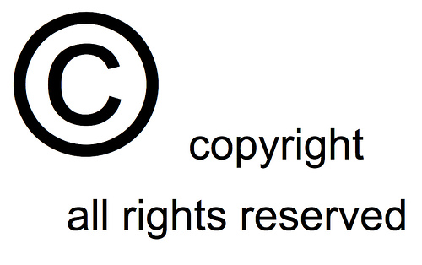
Copyrights
A copyright is the exclusive right of an author to reproduce, publish, and sell his or her creative work.
This right can be assigned by contract to another individual.
Copyrights are registered by the Copyright Office in the Library of Congress; these are good for the life of the author plus 70 years.
Items such as books, magazines, newspapers, musical compositions, lyrics, dramatic works, paintings, etc. can be copyrighted.
If a copyright is infringed or violated, the owner of the right may sue for damages in the federal courts.

Slide 20
Patents
A patent grants a person the sole right to manufacture, use, or sell any new and useful art, machine, manufacture, or composition of matter, or any new and useful improvement thereof.
A patent is good for up to 20 years.
The term of a patent may only be extended by a special act of Congress.

Slide 21
Weights and Measures
Congress has the right to fix the Standard of Weights and Measures throughout the United States.
The power reflects the absolute need for accurate, uniform gauges of time, distance, area, weight, volume, and the like.
The metric system was legalized by Congress in 1866; this includes the use of grams, meter, kilometer, liter, and so on.
This ensures that a pound, etc. will weigh the same in each state.

Slide 22
Power Over Territories and Other Areas
Congress has the power to acquire, manage, and dispose of various federal areas
This power includes the District of Columbia, and federal territories such as Guam, Puerto Rico, and the Virgin Islands.
Military land is also included; arsenals, naval installations, dockyards, post offices, prisons, parks and forest preserves, etc.
Eminent Domain allows the Federal Government the inherent power to take private property for public use.
This also means that a homeowner may need to give up their land if a highway is needing to be built there

Slide 23
VI

Slide 24
Federal Land in the Western United States
Washington 38%
Montana 35 %
Oregon 57 %
Idaho 66 %
Wyoming 53 %
Nevada 89 %
Utah 72 %
Colorado 40 %
California 50 %
Arizona 73 %
New Mexico 46 %

Slide 25
Why do certain agencies own so much land?
Nearly 30% of U.S. territory are Federal lands
Federal lands are used as military bases or testing grounds, nature parks and reserves and Indian reservations, or are leased to the private sector for commercial exploitation (e.g. forestry, mining, agriculture).
These lands are managed by different administrations, such as the Bureau of Land Management, the US Forest Service, the US Fish and Wildlife Service, the National Park Service, the Bureau of Indian Affairs, the US Department of Defense, the US Army Corps of Engineers, the US Bureau of Reclamation or the Tennessee Valley Authority.

Slide 26
Judicial Powers
Due in part to the system of Checks and Balances, Congress has several judicial powers.
These powers allow Congress to define federal crimes and set punishment for violators of federal law.
A few Federal crimes defined in the Constitution include counterfeiting, piracies, and felonies on the high seas, and offenses against international law.

