Slide 1
Government and Policymaking
A Chapter 6 Production

Slide 2
Part 1: Classifying governments

Slide 3
When classifying governments, you can ask five questions to help you classify them:
Who can participate?
How is power distributed?
How are the legislative, executive, and judicial branches structured?
What is the relationship between the legislative and executive branch?
What type of electoral systems do they have?

Slide 4
1. Who can participate?
The two classifications are:
authoritarian:
individual freedom is held as completely subordinate to the power or authority of the state,
centered either in one person or a small group that is not constitutionally accountable to the people.
Democratic
principle of political or social equality for all

Slide 5
2. How is power distributed?
Political scientists will ask whether power is centralized or decentralized
DECENTRALIZED
Federal systems of government are decentralized.
CENTRALIZED
Unitary systems are centralized.

Slide 6
Federal Systems
Advantages
Protects ethnic, linguistic, or religious minorities.
Serves as a check on ambitious rulers and protects markets and citizen freedoms
Allows for experimentation.
Citizens may choose the policy that best fits them at the regional level.
Disadvantages
Limited equality because citizens get different treatments and benefits from different local governments.

Slide 7
Unitary Systems
Advantages
Are in a better position to redistribute resources from richer regions to poorer regions (thus creating more equality)
Disadvantages
Local needs are often overlooked by the central government.

Slide 8
Sometimes, leaders of unitary systems voluntarily choose to decentralize power
Why?
To pacify political rivals (intra- or interparty rivalry; devolution in the United Kingdom as an example).
To prevent revolution.
Ethnic/regional/national cleavages.
To increase legitimacy.
To increase political participation.
Political efficiency (such as distribution of services and tax collection).
To increase accountability of local leaders (e.g., China)

Slide 9
Methods used to decentralize power
Give more power to Subnational or local levels of government.
What is it called when more power is given to local levels of government?

Slide 10
When this happens, there is still a distinct difference between a federal system, however:
Power can be taken away in a unitary system (by the central government).
Subnational government’s powers are not constitutionally protected.
In a unitary system decentralization is not necessarily symmetrical.
Local legislature/government can be dissolved in unitary systems but not in federal systems.

Slide 11
3. How are legislative, executive, and judicial branches structured?
A Sub-lecture on Presidential v. Parliamentary Systems

Slide 12
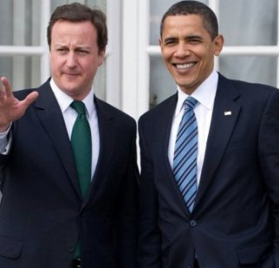
President and Prime Minister
http://www.youtube.com/watch?v=0BifNYKsLlE&feature=related
http://www.youtube.com/watch?v=MmlOOL2XuIs&feature=related
http://www.youtube.com/watch?v=U3DHKni1mu8&feature=related

Slide 13
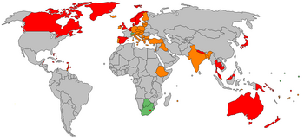
Nations with Prime Minister Systems
Red-pure systems
Yellow and green—adapted systems

Slide 14
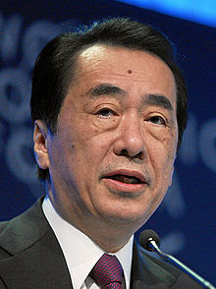
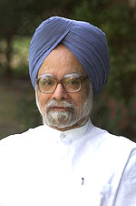
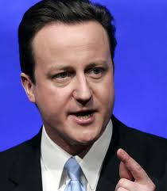
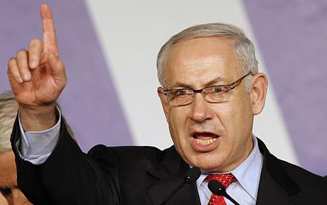
Naoto Kan
Manmohan Singh
David Cameron
Benjamin Netanyahu

Slide 15
Chairman or Chief?
Chairman—facilitator of government
Chief—forceful leader of government, leader of policy agenda

Slide 16
Presidential Systems--blue

Slide 17
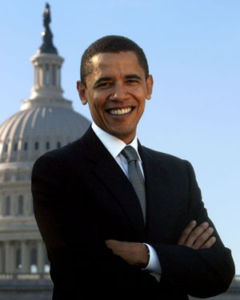
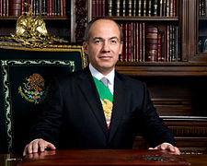
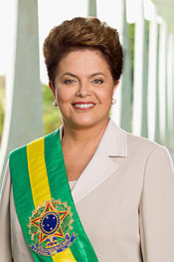
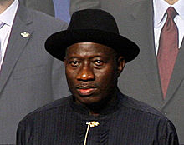
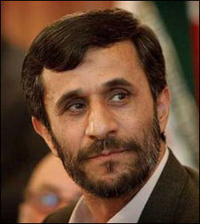
Felipe Calderón
Barack Obama
Dilma Rousseff
Goodluck Jonathan
Mahmoud Ahmadinejad

Slide 18
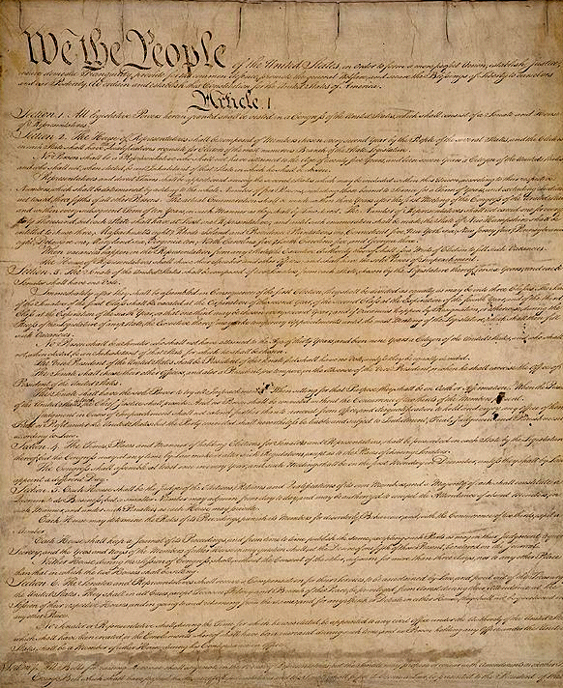
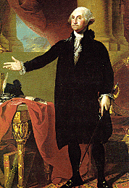
Origins of Presidential System

Slide 19
Hamilton’s Federalist Papers 67-77

Slide 20
Federalist Number 69
Four year term, elected not hereditary
Limited length of term
Can be removed through impeachment
Congress can override veto
Commander-in-chief only of those in service
Can’t dissolve Congress
Treaties must be approved by Senate
In short, a president like the governor of New York, not like a king

Slide 21
Federalist Number 70
Need for energy in the executive
“a feeble executive implies feeble execution of the government”
Unity in the executive
Limited length of terms
Adequate support
Competent powers
But safety against a tyrant

Slide 22
 | Parliamentary System | Presidential System
Legislative Branch | Parliament elected by voters. The majority party in Parliament chooses the prime minister. | Congress elected by voters. Legislative and executive functions are separate.
Chief Executive (Government Head) | Prime minister who heads council of ministers, or "Cabinet" | President, elected by voters, nominates cabinet members.
Head of State | Often a constitutional monarch. Legislatures often choose a ceremonial president, who acts as head of state. | President is head of state.
Elections | Prime minister can call new elections. | Held at fixed intervals.
Political Parties | Often a multiparty system. Government is formed by a ruling coalition of cooperating parties. | Usually a two-party system with third parties holding marginal power.
Examples | Israel, Great Britain, and her former colonies, such as India, Japan. | The United States, Mexico, Nigeria and Brazil.

Slide 23
Presidential System Advantages
Separation of Powers/Checks and Balances
Direct Mandate
Executive authority/decisive authority
Stability

Slide 24
Presidential System Disadvantages
Independent power can lead to authoritarianism
Separation of Powers/Gridlock
Difficulty in leadership change

Slide 25
Prime Minister System Advantages
Quicker Legislative Action
Collective Cabinet Authority—diversity in leadership
Flexibility in Change of Power—votes of no confidence
Resistance to authoritarianism

Slide 26
Prime Minister System Disadvantages
Indirect election of prime minister
No separation of powers—executive authority less checked
No single executive—first among equals
One party dominance
Potential instability

Slide 27
Similarities Between Presidential and Parliamentary Systems
Chosen through competitive party structures. This often leads to smoother transitions of power.
Primarily responsible for foreign policy decisions.
Perform system functions… for example, a child’s first encounter with politics is usually through a president or prime minster.

Slide 28
Comparing Cabinets
PRESIDENTIAL CABINETS
The president selects cabinet members and, sometimes, must go through legislative approval.
Role is limited.
PARLIAMENTARY CABINETS
The entire cabinet is subject to the legislature and the prime minister (PM) is just the “first among equals.”
The PM must maintain the confidence of the parliamentary majority so they must consult the legislature when choosing a cabinet.
**There are distinct differences in how a cabinet is formed depending on whether there is a two-party or multi-party system

Slide 29
Bureaucracies and Other Bodies

Slide 30
Bureaucracies
The bureaucracy has almost exclusive control over implementing laws and regulations.
Executives and bureaucracies mutually depend on each other. Executives need bureaucracies to carry out their policies and make decisions, while bureaucracies need guidance, direction, and resources from the executive.
Examples of mutual cooperation: creating budgets and reorganization of administrative capabilities.

Slide 31
Bureaucracies
Bureaucracies are often called “quasi-legislative” because they often have experts clarify legislation.
Bureaucracies can also perform “quasi-judicial” functions because they ensure laws are followed. They monitor and penalize citizens or organizations that do not follow their laws.
Laws are, typically, general so implementing and enforcing policies often depends on the interpretations of the bureaucracy. They also have some leeway as to how much they want to enforce certain laws.

Slide 32
Discussion
Max Weber says that bureaucracies have the following features:
Decision making powers based on jurisdictions, rules, and regulations
Formal and specialized educational training.
Hierarchical command structure (pyramid command) where the command/subordinate relationship is clearly defines. Information flows upwards and decisions flow downward.
Decisions are based on standard operating procedures.
Officials hold career positions, are appointed or promoted based on merit, and have protection against political interference.

Slide 33
Bureaucracies
ADVANTAGES
They promote consistency, competency, fair treatment, and freedom from political influences.
Example of an American institution free from political influences?
DISADVANTAGES
They tend to be stodgy, rule-bound, inflexible, and insensitive to the needs of citizens.
Few incentives to be innovative and efficient.
Many citizens are tired of bureaucracies due to this lack of efficiency and responsiveness.

Slide 34
Legislative Bodies
Assemblies vary in size and organization. Some have one house (unicameral) and some have two (bicameral).

Slide 35
Legislative Bodies
All assemblies have committee structures
Functions of assemblies include deliberating, debating, and voting on policies that come before them. Their decisions about these policies carry the force of law.
Other functions include controlling public spending and appointment powers.

Slide 36
Assemblies vary in importance in various nations. (not in handouts)
U.S. Congress Extremely active role in forming public policy. | House of Commons in Britain Public policy is usually initiated by the cabinet members and this house is usually a deliberating body that formally enacts and amends legislation. | National People’s Congress (China) Essentially, a tool of party leaders. They meet and listen to statements by party leaders and “rubberstamp” decisions made by someone else.

Slide 37
Legislative Bodies
Assemblies are, in theory, representatives of the people. The idea that officials should mirror the characteristics of the citizens as much as possible is known as descriptive representation.

Slide 38
Judicial Bodies
Constitutional Courts are the fourth type of government body (bureaucracy, legislative, executive branches).
The constitutional court is the highest judicial body that rules on constitutionality of laws and other government actions.
Judicial power has grown over the past century because of the desire to protect human rights.

Slide 39
4. What is the relationship between the legislative and executive branch?

Slide 40
PRESIDENTIAL
Branches separate, independent, and co-equal. Chosen independently of legislature, fixed term, and broad powers not controlled by legislative branch.
Checks and balances
Mostly located in Western Hemisphere.
PARLIAMENTARY
Executive (Prime Minister, Premier, President) is from legislative branch.
Leader from majority party and chosen from legislative body.
Subject to control of Legislature
Majority of governments in the world have parliamentary government.

Slide 41
Vote of Confidence
A vote of confidence may occur in a parliamentary system when the majority party in the parliament disagrees with a policy or action of the prime minister.
If the majority party and the prime minister are in a disagreement on an issue, the prime minster is expected to dissolve the parliament and call for new elections.
If citizens vote for a different party to become the majority party, then a successful vote of confidence has taken place.
https://www.youtube.com/watch?v=ptFhhz5Lrqk
https://www.youtube.com/watch?v=vJwqhkVmfRg

Slide 42
5. What type of electoral systems do they have?
Types of Electoral Districts
Single Member Districts. AKA “winner take all”, “first past the post”
Follow plurality election rules

Slide 43
2. Proportional representation is where the nation is divided into a few, large districts and competing parties offer a list of candidates rather than a single candidate. The number of representatives in the legislature is proportional to the percentage of votes it gets.
Many nations have a minimum threshold of voters (3-5%)

Slide 44
Referendum
Defined
the principle or practice of referring measures proposed or passed by a legislative body to the vote of the electorate for approval or rejection.
Advantages to political leaders when holding a referendum:
Avoid responsibility.
Enhance power of executives
Bypassing the legislature.
More democratic
Shift accountability.
Forces decision/shuts off debate
Legitimacy.

Slide 45
Initiatives
Some nations allow initiatives. This is done by getting a certain number of signatures from the public, which obligates the government to hold a national referendum.

Slide 46
Political Parties
Advantages to a 2 Party System:
There is a closer relationship between representatives and constituencies
Governments are more stable
The two-party system is more efficient at governing and lawmaking than a multiparty system
The two-party system simplifies voters’ decisions
The two-party system promotes a greater consensus.

Slide 47
Political Parties
Multiparty systems have a combinations of parties, voter support, and election laws that ensure that no single party wins a legislative majority.
Advantages:
The multiparty system provides representation for a greater number of ethnic groups
Parties are more accountable
Parties are more representative of different divisions in society.

Slide 48
Political Parties
Sometimes, a single party system emerges for a variety of reasons:
A revolution or coup that installs a single party. (Russian Revolution)
Emergence of a charismatic leader
An economic crisis that leads citizens to unify around a single leader/party.
Constitutional imposition of a single party (NAZI Party in Germany)
An external threat that leads citizens to unify around a single party.
Ethnic/religious fragmentation.
Advantages:
Creates stability by enacting uniform policies
More efficient
Acts with a single voice
Unites different ethnicities into one group.

Slide 49
Supranational Organizations

Slide 50
Supranational Organizations
Supranational Organizations are those who have been given some sovereignty because nations have shifted their powers upwards to them. This shift took place after WWII.
*Even though these organizations are important, the state is still the most important political system in the world!*

