Slide 2
Defining Interest Groups
Interest Groups Versus Political Parties
Purpose & priorities of Political Party?
Purpose & priorities of Interest Group?
Interest
Groups
An organized group of people who share some goals and try to influence public policy.
Notes:
10-1 Interest Groups

Slide 3
Why Interest Groups Form
Social issues such as industrialization, urbanization, immigration and government responses;
Responses to government actions;
Technological changes which allow people to contact government

Slide 4
Why People Join
Because of a group’s political goals or causes;
For economic and social reasons;
For monetary or other benefits (low insurance rates, health policies, investment counseling)

Slide 5
Which People Join
People with higher incomes and education are most likely to join interest groups

Slide 6
Have Americans Stopped Joining?
The loss of close, personal relationships seems to indicate that the discussion of public issues and trust among citizens is in decline;
People say they are busier than ever and have little time for outside organizations;
Membership in professionally managed issue advocacy groups is increasing

Slide 7
Five Main
Functions of
Interest Groups?
Represen-tation
Education
Programming
Monitoring
Political
Participation
Agenda
Building
Notes:
10-1b Five Functions of Interest Groups

Slide 8
Role & Functions of Interest Groups
Five main functions of Interest Groups:
Representation – interest of members
Political Participation – enable people to participate
Government and Politics
Education – members, public, & government officials
About issues of interest & why IG goals should be supported
Agenda building- push new issues onto public agenda
Examples: Consumer protection & Veterans issues
Program Monitoring- watch how laws are administered
Assess Federal or State Government regulation

Slide 9
The Growth of Interest Groups
History & evolution of “factions”
De Tocqueville’s observations “forming associations”
Anti-slavery association of 1833
National Woman Suffrage Association of 1869
The Grange of 1860s (anti-Railroad monopolies)
Significant Interest Group (IG) growth since 1942:
From 600 IGs in 1942 to => 7000+ in 1995
Why the growth of Interest Groups?

Slide 10
Increased Demands on Government
More demands of public placed on Government:
Civil Right & Anti-Vietnam War Legacy
Improvements & advances in technology
Rise of new issues almost every day

Slide 11
Diversity of Organized Interests
Three general categories of Interest Groups:
Economic Interest Groups
Citizen Interest Groups
Government Interest Groups
Examine each in greater detail=>

Slide 12
Interest Group Formation and Maintenance
Reasons why interest groups form?
Disturbance Theory =>
Usually in response to Government policy
Threat to the status quo – The Cat Mother response
IGs form mostly in response to some government policy:
Policies affecting or potentially affecting members’ interests
Most are directly related to politics => influence gov. policy
Also some IGs formed for reasons unrelated to politics
Whose interest is usually represented?
Rich & powerful - why?
Social-economic status => political activism

Slide 13
Obstacles of Interest Group Formation
The Collective Goods Dilemma?
A dilemma created when people can obtain the benefits of interest group activity without paying any of the costs associated with it.
(In this situation, the interest group may not form because everyone has an incentive to let someone else pay the costs of group formation.)
People who benefit w/o paying are called?*
Notes:
10-3d Collective Goods Dilemma

Slide 14
Free Riders
People or groups who benefit from the efforts of others without bearing any of the costs.
So how are such obstacles to IG formation overcome?
Notes:
10-3d Freerides

Slide 15
Overcoming Obstacles to Interest Group Formation
Political entrepreneurs=>
Cat Mother (local) vs. Ralph Nader (National)
Government or wealthy sponsor funds IG
Or – IGs attract & motivate prospective members
How are new members potentially attracted?
New members are offered what?
Selective benefits (vs. collective benefits)
What are the three types of selective benefits?*

Slide 16
Three Benefits from Interest Groups
Material
(stuff)
Solidarity
(identity)
Expressive
(purpose)
Notes:
10-4 Benefits from Interest Groups

Slide 17
Material?
The actual goods and services that come from belonging to an interest group.
Examples?
Notes:
10-4 Material Benefits

Slide 18
Solidarity
The emotional and psychological enjoyment that comes from belonging to an interest group whose members share common interests and goals.
Notes:
10-4 Solidarity Benefits

Slide 19
Expressive
The feelings of satisfaction people derive from working for an interest group cause they believe is just and right. Also known as purposive benefits.
Notes:
10-4 Expressive Benefits

Slide 20
Material
Selective Benefits:
Any benefit given to a member of a group, but denied to nonmembers
Solidarity
Expressive
Notes:
10-4 Selective Benefits

Slide 21
Interest Group Bias
Affluent & better educated over =>
Poor and less educated- Why?
The higher the socioeconomic status=> the more likely to be actively involved in politics
Some exceptions – Cesar Chavez against=>
Wealthier California grape growers during ’70s
Chavez was soon joined by young idealistic activists
Still raises questions about=>
Democracy & political influence of few elite over many non politically involved

Slide 22
Interest Group Strategies
Four major IG Strategies:
Political Action Committees (PACs)
Lobbying the Government
Mobilizing Public Opinion
Litigating
Let’s examine each strategy in greater detail=>

Slide 23
IG Strategy #1: Political Action Committees
Organizations that solicit contributions from members of interest groups and channel those contributions to election campaigns-
(usually for those candidates supporting policies favorable to members of the Interest Group- though not always).
Notes:
10-5a Political Action Committees

Slide 24
Creating Political Action Committees (PACs)
Since election reforms of early ‘70s =>
PACs grew significantly at different rates (Fig. 10-1)
Various categories of PACs grew at different rates
Corporate (most growth)
Non-connected
Trade, Membership, & Health
Labor (in decline)
Other PACs (Table 10-1 examples)
PAC spending has also changed wrt the Political climate
Examine these changes is following charts and tables*

Slide 25
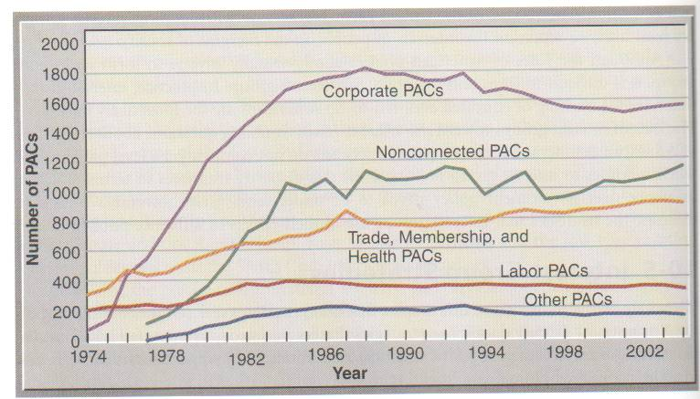
Growth in Political Action Committees (PACs), 1974-2004
Notes:
10-5a Growth in Political Action Committees

Slide 26
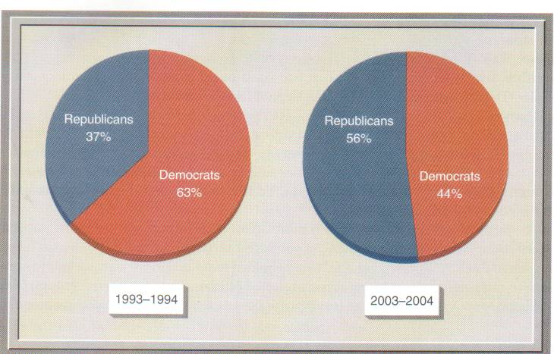
Changes in PAC Contributions to Congress- Recent Comparison

Slide 27
IG Strategy #2: Lobbying the Government
Lobbying?:
Trying to influence governmental decisions, especially the voting decisions legislators make on proposed legislation.
Notes:
10-5b Lobbying

Slide 28
Lobbying the Government (#2)
lobbying & lobbyists, & direct lobbying
Targeted attempts to influence policy
Through personal contact of government officials
Plead clients case directly to official
Credible information key to effectively lobbying
Usually lobby officials of similar views
Support draft legislation & research
Lobbyists know how government process works
Many are former Executive appointees or Congressmen
Problem: potential conflict of interest
What are the different ways to lobby?

Slide 29
Types of Lobbying
Grass-
Roots
Lobbying
Direct
Lobbying
Education
Campaigns
Advocacy
Advertising
Notes:
10-5b Types of Lobbying

Slide 30
Direct
Lobbying
Trying to influence public policy through direct contact with government officials.
Notes:
10-5b Direct Lobbying

Slide 31
Lobbying to Mobilize Public Opinion
Various methods used to mobilize Public Opinion:
Education Campaigns =>
Key tool for education of Public: advocacy advertising
Educate public by publishing research studies
Normally supporting Interest Group’s policy positions
Grass-Roots Lobbying – very effective with Congress
Petition drives (Which Amendment Right?)
Letters, phone calls, or e-mail to Congress or Admin
Effective way to get elected officials attention
Marches & demonstrations
Get out the vote efforts

Slide 32
Education
Campaigns
Interest groups try to mobilize the public through education hoping that the public will demand government action.
Notes:
10-5b Education Campaigns

Slide 33
Advocacy
Advertising
Newspaper, television, and radio advertisements that promote an interest group's political views.
Notes:
10-5b Advocacy Adversiting

Slide 34
Grass-
Roots
Lobbying
Trying to influence public policy indirectly by mobilizing an interest group's membership and the broader public to contact elected officials.
Notes:
10-5b Grass-Roots Lobbying

Slide 35
Other Types of Lobbying
Astroturf
Lobbying
Civil
Disobedience
&
Notes:
10-5b More Types of Lobbying

Slide 36
Astroturf
Lobbying
Efforts, usually led by interest groups (or Corporations) with deep financial pockets, to create synthetic grass-roots movements by aggressively encouraging voters to contact their elected officials about specific issues.
Notes:
10-5b Astroturf Lobbying

Slide 37
Civil
Disobedience
Civil disobedience is the practice of breaking laws in order to pressure legislators to change perceived unjust laws.
Notes:
10-5b Civil Disobedience

Slide 38
IG Strategy #3: Litigating
When you lose with the Congress => then what?
You can always sue
Last action in a continuing cycle –
(There’s always next year)
Examples:
1950s De Jure Segregation- NAACP
Clean Air Act & Endangered Species Act
Campaign Reform
Amicus Curiae brief?

Slide 39
Interest Group Influence
Two factors determining degree of IG influence?
External & Internal Factors
External Factors – those beyond group’s control
Party in power (President and/or Congress)
Business & tax cuts more likely when who’s in power?
Union interests more likely to be + considered by who?
Opposition Interest Groups => generated in response
Opposing IGs tend to cancel each other out
Better chance with no opposition (Veterans’ Groups)
(Budget proposal to cut Veterans’ Health Care- chance?)

Slide 40
Internal Factors of
Interest Group Influence?
Membership
Leadership
Objectives
Financial
Resources
Notes:
10-6 Internal Factors of Interest Group Influence

Slide 41
Internal Factors => (4):
Membership- (size and commitment) – esp. who votes!
(Recall demographic factors & socio-economic status)
Leadership- must understand how Washington works
Effectively manages group’s interests
Able to maintain focused & cohesive membership
Financial Resources- in general more $ better than less
Contribute to political campaigns => buys access to lawmakers
Hire lobbyist who give parties that Congressmen attend
Conduct media campaigns (Insurance companies defeat HRC)
Buy state of the art equipment – direct mail operations
What do less funded groups do to compensate?
(How to get free media & capture public’s attention?)
Objectives => the narrower & less known the better –
Why? (Recall Disturbance Theory)

Slide 42
The Balance Sheet on Interest Groups
Americans have love/hate relationship with IGs
Another case of Theory versus Reality- why?
In Theory: general disdain for factions or “Special Interest”
In Reality: Support (at various levels) for specific interests
(see Figure 10-4)*
Disagreement over virtues of different Interest Groups
Many times generated opposition (disturbance theory)
Great diversity & interests interact and conflict (Figure 10-4)*
One common thread appears throughout:
Wealthy & more powerful better represented – Why?

Slide 43
Calls for Reform
Complaints re. rich & powerful interest favored over rest
Prompt calls for reforms to change rules (& outcomes)
Limited changes made by Congress:
Limit $$$ gifts to Congress mbrs (but also raised pay at same time)
Greater disclosure policies – must identify lobbyists (Text cartoon)
See Text - (Box 10-2): Lobbyists’ influence on Congress
Early Campaign Finance Reform – limited reforms made
Limited PAC $$$ & increase individual contribution
1st Amendment Rights – challenge by opponents- always sue
All citizens have Constitutional right to petition the government
Problems: also unintended consequences – (loop holes)
For example: 1970s reforms resulted in Growth of PACs
Recent Reforms & Court rulings => growth of Soft Money

Slide 44
The Contributions of Interest Groups:
Represents views of IG members to Government
Enables people to participate in political process
Educates public about potential issues affecting them
Pushes new issues onto the political agenda
Monitors Government action & pushes for change
Examples: Women’s suffrage & civil rights laws
Upholds right of Americans to petition Government
(First Amendment right upheld)
IGs now ingrained as integral part of American political process

