Slide 1
Political Action Committees

Slide 2
Section 1: History of PACs
From Taft-Hartley to FECA

Slide 3
1947—Taft Hartley
1947-Taft-Hartley was passed to monitory the activities of labor unions.
It influenced politics in one simple way:
Unions/corporations couldn't’t spend any money on politics whatsoever….
Those crafty unions got around it by creating political action committees that their members could donate to, and then use those funds to donate to campaigns.

Slide 4
1971-FECA
1971-Congress passes the Federal Election Campaign Act. There were the following limitations:
Individuals limited to $5000 in donations.
Corps/unions cant directly contribute
Corporate Pacs may only ask execs, shareholders, and families
Union PACs only from their members
Independent PACs only from the General Public

Slide 5
FECA Part 2
Here are the limits of PACs on donations:
$5000 to a candidate or candidate committee
$15000 to a political party
$5000 to another pac
Unlimited Expenses

Slide 6
Part 2: Types of PACS

Slide 7
The Categories Are…
The early categories of PACs are:
Corporate
Non-connected
Trade, Membership, & Health
Labor

Slide 8
Today’s Categories
Today’s Categories are:
Connected PACS (tied to businesses/unions)
Non-Connected PACs (Single Issue Groups)
Super PACs
Independent expenditure only committees.
Can’t contribute to a particular campaign or party, but can spend independently of the campaign.

Slide 9
Growth in Political Action Committees (PACs), 1974-2004
Notes:
10-5a Growth in Political Action Committees

Slide 10
PAC Spending 2003-2004
Notes:
10-5a PAC Spending

Slide 11
Changes in PAC Contributions to Congress
PACs gave nearly two-thirds of their congressional campaign contributions to Democratic candidates when the Democrats were the majority party on Capitol Hill.
1993-1994
Notes:
10-5b PAC Contributions to Congress

Slide 12
Changes in PAC Contributions to Congress
When the Republican Party gained control of Congress, that donation pattern reversed. During the 1997-1998 election cycle, Republican candidates received a majority of PAC contributions.
1997-1998
Notes:
10-5b PAC Contributions to Congress #2

Slide 13
Changes in PAC Contributions to Congress- Recent Comparison

Slide 14
Section 3: Citizens United v. FEC

Slide 15
A Video-Summary
http://www.youtube.com/watch?v=k5kHACjrdEY

Slide 16
Section 4: Citizens United the PAC
My-Your Presentation

Slide 17
TOTALDONATIONS
$599,500
AMOUNT GIVEN BY CITIZENS UNITED TO CANDIDATES IN FEDERAL ELECTIONS IN THE 2010 ELECTION CYCLE.
OF THAT MONEY, $450,500 WAS SPENT ON THE HOUSE,$149,000 ON THE SENATE.

Slide 18
TOTALDONATIONS
0.016%
PERCENTAGE OF ALL MONEY SPENT IN THE 2010 ELECTION ($3,648,232,683) DONATED BY CITIZENS UNITED.
OF ALL MONEY SPENT ON REPUBLICANS ($1,772,688,000),0.034% CAME FROM CITIZENS UNITED.

Slide 19
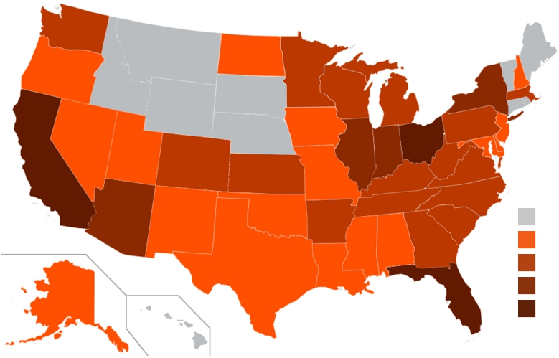
0
1-2
3-4
5-6
7
NUMBER OF RACES DONATED TO, BY STATE

Slide 20
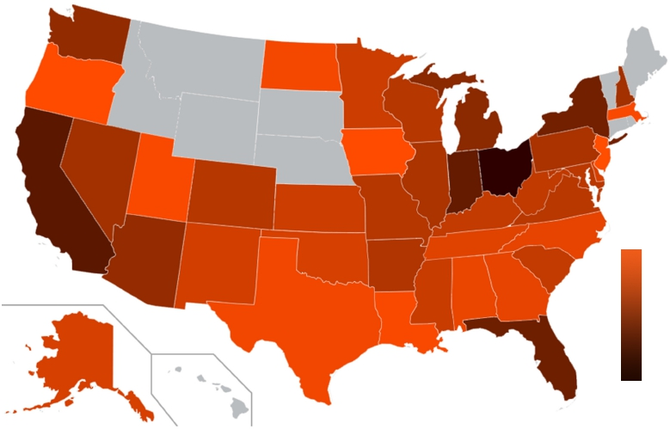
$500
$50,000
TOTAL AMOUNT DONATED, BY STATE

Slide 21
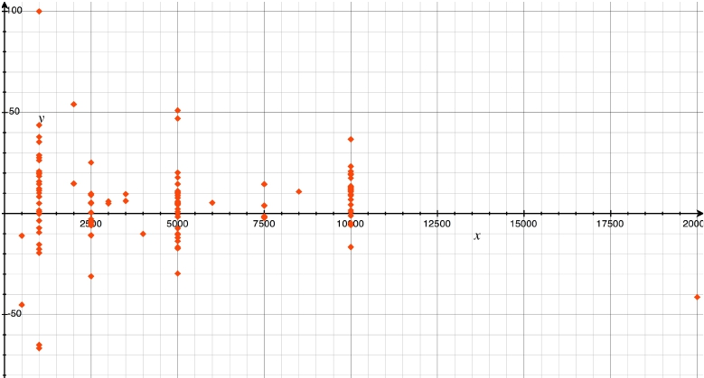
TOTALDONATIONS
%WONORLOSTBY
AMOUNTDONATED

Slide 22
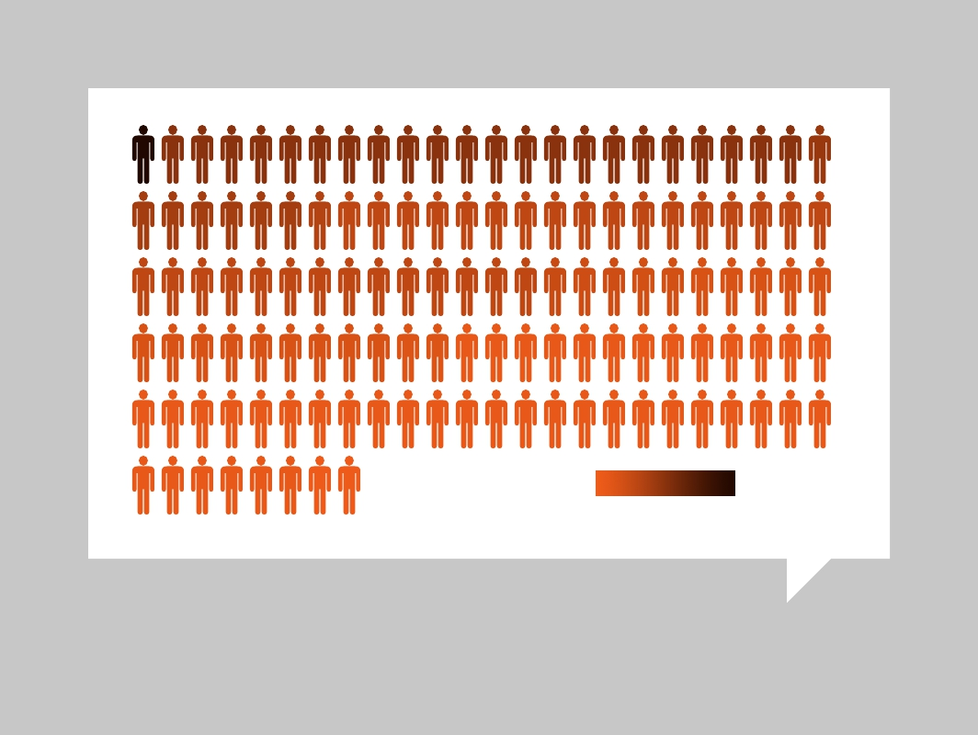
TOTALDONATION
$500
$20,000
AMOUNT DONATED PER CANDIDATE

Slide 23
KEYCANDIDATES
SHARRON ANGLE
KELLY AYOTTE
MICHELE BACHMANN
LOUIS BARLETTA
ROY BLUNT
DAN BURTON
BOB GIBBS
TIM GRIFFIN
FRANK GUINTA
DAVID HARMER
ANDY HARRIS
JOE HECK
DOUG HOFFMAN
MARK KIRK
THADDEUS MCCOTTER
JOE MILLER
CHRISTINE O’DONNELL
RAND PAUL
STEVE PEARCE
MIKE PENCE
ROB PORTMAN
DINO ROSSI
STEVE STIVERS
ALLEN WEST
$10,000
$20,000

Slide 24
IDEOLOGICAL
LEANING
IN THE 2010 ELECTION CYCLE, CITIZENS UNITED DIRECTLY CONTRIBUTED TO THE CAMPAIGNS OF 127 CANDIDATES. ALL WERE REPUBLICANS, EXCEPT FOR ONE CONSERVATIVE LEANING INDEPENDENT (DOUG HOFFMAN OF NEW YORK.)

Slide 25
IDEOLOGICAL
LEANING
ACCORDING TO THE CITIZENS UNITED WEBSITE,THE ORGANIZATION SEEKS
TO:
“REASSERT THE TRADITIONAL AMERICAN VALUES OF LIMITED
GOVERNMENT, FREEDOM OF ENTERPRISE, STRONG FAMILIES, AND
NATIONALSOVEREIGNTYANDSECURITY.”
AND TO:
“RESTORE THE FOUNDING FATHERS’ VISION OF A FREE NATION, GUIDED BY HONESTY, COMMON SENSE, AND THE GOOD WILL OF ITS CITIZENS.”

Slide 26
TRADITIONAL AMERICAN VALUES:
STRONG NATIONAL DEFENSE, CONSTITUTIONALLY LIMITED GOVERNMENT,
FREE MARKET ECONOMICS, BELIEF IN GOD AND JUDEO-CHRISTIAN VALUES,
AND THE RECOGNITION OF THE FAMILYAS THE BASIC SOCIAL UNIT OF OUR
SOCIETY.

Slide 27
KEYISSUES
ANTI-UNION
FREE-MARKET
ECONOMICS
PRO-ISRAEL
KEY ISSUES
PRO-LIFE
ANTI-AFFORDABLECARE
ACT (“OBAMACARE”)

