Slide 1
Poetry in the SS Classroom
Dustin Rimmey—Topeka High School

Slide 2
Overview
Why Poems?
Acrostics
Cinquains
Found Poems
Slam Poems

Slide 3
Why Poems
More challenging than a definition
More thought provoking than a summary
Cross-curricular thinking
Mildly entertaining to watch kids write
Increases mental sweat
Fun to grade

Slide 4
Acrostic Poetry
P. 146—AVID Write Path

Slide 5
Your Own Acrostic
Define the word POLITICS
  You have 30 seconds
Now, write the word POLITICS on your paper like this:
  P
  O
  L
  I
  T
  I
  C
  S

Slide 6
A Student Sample
Popular
Over-emphasized
Liberty
Integrity
Trends
Institutions
Civil
Society

Slide 7
Opposing Content Acrostics
Limited Government
Is just not our style
Bureaucracy is created to promote
Equal rights and opportunities
Radicals are too extreme
Access to social services promote quality
Lives for everyone
Change is not for us but don’t call us
Old fashioned
No use in changing the
Status quo if it increases government action
Economically speaking, keep it lassiez faire
Restrictions and regulations only stunt growth
Very fond of Reagan
And Barry Gold Water too!
Their ideas
Inspire us to
Vote at
Every Opportunity

Slide 8
A Useful Website
http://www.joglab.com/wordfinder.htm
Will help generate base words for younger students or students of differing ability levels

Slide 9
Cinquain Poems
P. 151

Slide 10
The Formula
Name of Person/Concept
Two Adjectives
Three Verbs
Simile (like a or as a)
Synonym for the first line (Name/Concept)

Slide 11
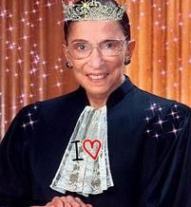
Ruth Bader Ginsburg
Ruth Bader Ginsburg
Oldest, Liberal Constructionist
Respected, Pressured to Retire, Promotes Rights
As feisty as Antonin Scalia
America's Judicial Sweetheart!

Slide 12
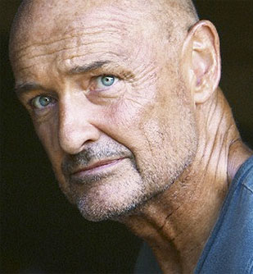
John Locke
John Locke
Empiricist, Philosopher
Widely Cited, Promotes Democracy, Advocates Rebellion
He believes the mind is as blank as a slate
Social Contract Theorist

Slide 13
Vocab Terms
Nomad
Travelers, Immigrants
Migrating, Hunting, Gathering
As free as the wind
Travelers
War
Violent, Costly
Fighting, Changing, Killing
As deadly as a plague
Conflict

Slide 14
Other Styles and Examples
http://hrsbstaff.ednet.ns.ca/davidc/6c_files/Poem%20pics/cinquaindescrip.htm

Slide 15
Found Poems
P. 156

Slide 16
You have an Article
Take 3 minutes to read it
As you read it mark the text
  Both for information
  And, Make a list of 15-20 words/phrases that either stick out or help show the essence of the author’s intent
Now, take your list, and try to create a “poetic” summary using the words from your list and only your list

Slide 17
Student Examples—Federalist 10
The first question….
What, then are the distinctive characters of the republican form?
The union as a confederacy with indefinite supremacy
The genius of the American people: federal and not national, national not federal
The plan of the convention—the assent and ratification of the people
Subordinate to the supreme, the ultimate authority resides with the people alone

Slide 18
More Examples
What, then, are the distinctive characters of the republican form?
We may define a republic to be, essential to such a government
Derived from the great body of society.
What, then are the distinctive characters of the republican form?
Sufficient for such government that the persons administering it be appointed by the people
And it is asked by what authority this bold and radical invitation was undertaken?
From this aspect of government it appears to be of a mixed character.
As many federal as national figures
What, then, are the distinctive characteristics of the Republican form?
Neither wholly federal, or wholly national

Slide 19
The Shopping List Example
Federalism functions
Systems, states, society
Performing, Political, Population, Power
Majority, maintain, mechanism
Liberties, Loyalties
Testimony
Viable, vis-à-vis, vitality
But budgetary boundaries
Chaotic conflict
Flexible Functions
Government Goals
Simplicity
Adaptation, Administrations
Separate, Strength, Support
People

Slide 20
The outside language variation
We don't need a revolution
Just ratify the Constitution
Through this ratification
We will have one equal nation
If the national can be come federal
Decisions will be credible
Putting aside our political rivalries
We can live in a co-equal society

Slide 21
Slam Poetry
http://rimmeysapgov.weebly.com

